Slide 1
Chat with your Data Using Fabric and OpenAI
Dennes Torres

Slide 2


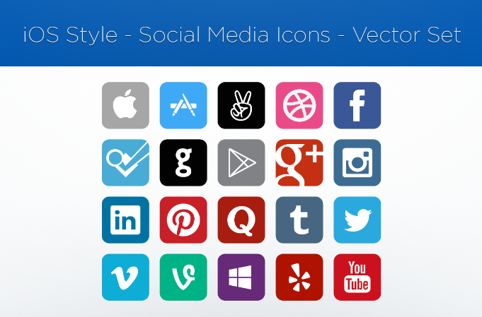





Dennes Torres Data Platform MVP (Alumni)
Onyx Data & Dtower Software
Trainer
MCT, MCSE Data Platform, MCSE BI, MCSD Web Development
Malta Data Platform UG Leader
Malta
MMDPUG
https://dennestorres.com
Dennes.Torres
@Dennes
https://br.linkedin.com/in/dennestorres
dennes@bufaloinfo.com.br
http://youtube.com/c/dennestorres
+356 99698932

Slide 3
Agenda
Semantic Kernel on notebooks
Architecture for Relational Access
More About OpenAI
Chat Solution Accelerator
Custom Architecture
Machine Learning vs LLM
Chat with Your Data Methods
Vector Index

Slide 4
What we are talking about
Use Large Language Models to extract information and conclusion

Slide 5
Machine Learning vs LLM

Slide 6
Machine Learning vs LLM
Machine Learning | Large Language Model
Model means an algorithm which requires training | Models are pre-trained

Slide 7
Machine Learning vs LLM
Machine Learning | Large Language Model
Model means an algorithm which requires training | Models are pre-trained
Model training is for one specific purpose | Model training includes knowledge ingestion (but we usually don’t do that)

Slide 8
Machine Learning vs LLM
Machine Learning | Large Language Model
Model means an algorithm which requires training | Models are pre-trained
Model training is for one specific purpose | Model training includes knowledge ingestion (but we usually don’t do that)
The trained model analyses one specific dataset schema | The model provides answer about any knowledge ingested

Slide 9
Machine Learning vs LLM
Machine Learning | Large Language Model
Model means an algorithm which requires training | Models are pre-trained
Model training is for one specific purpose | Model training includes knowledge ingestion (but we usually don’t do that)
The trained model analyses one specific dataset schema | The model provides answer about any knowledge ingested
It can make predictions over the trained dataset | The Model can be associated with Search Services and using its language knowledge, it will provide answers from indexed knowledge, answers from the past, not predictions

Slide 10
LLM is not a Bot
Bot | LLM
Uses a fixed workflow | Doesn’t have a workflow defined

Slide 11
LLM is not a Bot
Bot | LLM
Uses a fixed workflow | Doesn’t have a workflow defined
You can control precise answers to a subject | The control of the answers is limited
You use a Bot to control the workflow of the conversation. When the conversation goes out the planned flow, redirect to the LLM

Slide 12
Semantic Kernel on Notebooks

Slide 13
Semantic Kernel on Notebooks
Coding Library
It can be used in notebooks
It connects to Open AI Service
It uses the concept of Skills
The skills are System Prompts

Slide 14
Semantic Kernel
You can access OpenAI in Azure
Fabric has native OpenAI resources

Slide 15
Semantic Kernel

Slide 16
Chat with Your Data Methods

Slide 17
Core “Limitation”
LLM Model has a token limit by call
It’s impossible to search all your data for answers
“Wizards” and tools hide this fact

Slide 18
Two Solutions
Use a vector index
Explain the Data Model

Slide 19
Vector Index

Slide 20
Vector Index
Widely spread method
Hidden by tools and wizards where you less expect
Best for unstructured data
Better for static data

Slide 21




Vector Search Architecture
Text Embeddings
Store the Results
Extensions
Embedding Model
LLM Model
Search Related Information
AI Search
Create Embeddings
API
Sends the prompt to the LLM Model
Builds an LLM prompt with the question and system prompt
Asks a Question
Ingest Document
BackEnd App
FrontEnd

Slide 22
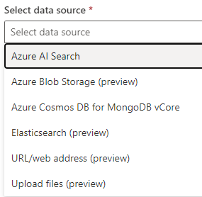
Sources to Feed Open AI Model

Slide 23
Vector Search in Open AI Playground

Slide 24
Explain the Data Model

Slide 25
Explain the Data Model
Use the System Prompt
Explain the meaning of the model
Ask to generate a retrieval statement
It can generate a SQL Query
You need to execute it later

Slide 26
Relational Access Architecture
Open AI
SQL Endpoint
SDK/Rest
SQL
Azure Function
Azure Function
Client Application

Slide 27
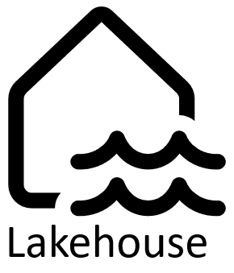



Relational Access Architecture
GPT Model
Frontend

Slide 28
Relational Access

Slide 29
Chat Solution Accelerator

Slide 30
Chat Solution Accelerator
Built for unstructured data
Azure Solution
Provided by Microsoft
Template deployment to Azure

Slide 31
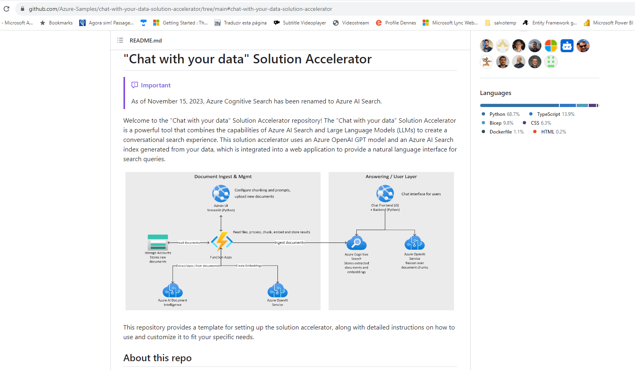

Slide 32


Slide 33





Azure Document Intelligence
Embedding Model
Cognitive Services Search
GPT Model
Trigger + Document
Index Search
Data + Embeddings
Question
Backend
Frontend

Slide 34
Chat Accelerator

Slide 35
Dennes Torres Data Platform MVP (Alumni)
Trainer
MCT, MCSE Data Platform, MCSE BI, MCSD Web Development
Malta Data Platform UG Leader
Malta
MMDPUG
https://dennestorres.com
Dennes.Torres
@Dennes
https://br.linkedin.com/in/dennestorres
dennes@bufaloinfo.com.br
http://youtube.com/c/dennestorres
+356 99698932

